Slide 1
Sources of Risk Capital
Dr. Narayanan Jayaraman
Georgia Institute of Technology

Slide 2
Objectives
In this session we want you to……
Understand informal and formal sources of capital
Discover how venture capitalists make decisions

Slide 3
Obtaining Risk Capital
Money is like a sixth sense without which you cannot make a complete use of the other five.
-Somerset Maugham

Slide 4
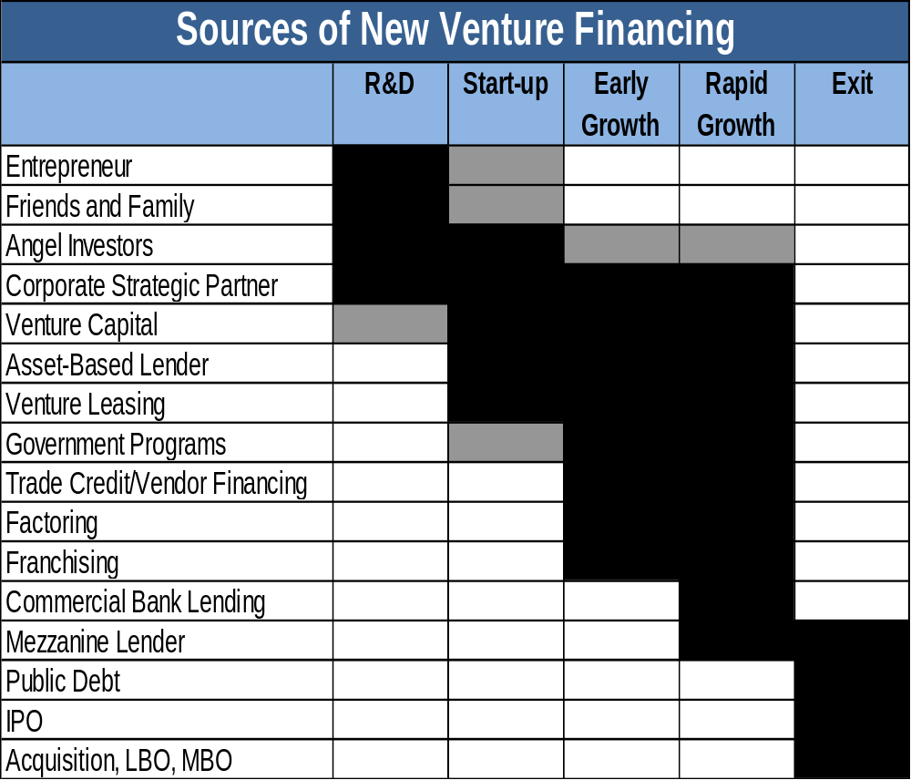
Notes:
Figure 2.1 – Sources of New Venture Financing
Black shading indicates primary focus of investor type. Gray shading indicates secondary focus, or focus of a subset of investors.

Slide 5
Sources of New Venture Financing:
Bootstrap Financing
Financing that does not depend on investor assessment of the merits of the opportunity or assets of the venture
May be from entrepreneur’s own resources or from friends and family
  personal savings (90%)
  credit card/personal loans (28%)
  loans from family and friends (7%)
  equity investment from family and friends (5%)

Slide 6
Sources of New Venture Financing:
Angel Investors
  Individual freelance investors usually interested in investing fairly small amounts ($25,000 - $500,000) in early-stage ventures
  Willing to invest over long horizons
  Evolved to a quasi-institutional form with angels acting as groups and may co-invest
  Often bring significant industry experience and are interested in active involvement

Slide 7
Sources of New Venture Financing:
Venture Capital
Venture Capital (VC)funds are organized as limited partnerships
  Limited partners (LPs) provide most of the capital
  General partner (GP) is responsible for managing the fund, including investment selection, working with entrepreneurs, and harvesting the investments
Focused on equity investment in high-risk ventures with large potential return

Slide 8
Amazon.com Financing
Date | Amount | Terms
July 1994 | $10,000 | From Jeffrey Bezos, in exchange for 10,200,000 shares of common stock ($.001 per share).*
July 5, 1994 | $15,000 | Interest-free loan from Jeffrey Bezos. Repaid Aug 1995.
November 1994 | $29,000 | Interest-free loan from Jeffrey Bezos. Repaid April 1995.
November 1994 |  | Jeffrey Bezos personal guarantee of obligations to Seafirst Bank
Feb 9, 1995 | $100,000 | From Miguel Bezos (father of Jeffrey), in exchange for 582,528 shares of common stock ($.1717 per share).
April 1995 |  | Jeffrey Bezos personal guarantee of Company credit cards
July 1995 |  | Jeffrey Bezos personal guarantee of obligations to Wells Fargo Bank
July 24, 1995 | $145,500 | From Gise Family Trust, Jacklyn Gise Bezos (mother of Jeffrey), Trustee, for 847,716 shares of common stock ($.1717 per share)

Slide 9
Amazon.com Financing
Date | Amount | Terms
Aug 7, 1995 | $5,408 | One investor, for 42,000 shares of common stock ($.1287 per share)
Nov 1995 | $40,000 | Interest-free loan from Jefrey Bezos. Repaid Nov 1995
Dec 6, 1995 | $50,000 | From Tom Alberg, for 150,000 shares of common stock ($.3333 per share). Alberg became a Company director in June 1996
May 3, 1996 | $20,000 | From Mark Bezos and Christina Bezos Poore (siblings of Jeffrey), for 60,000 shares of common stock ($.3333 per share)
Dec 6, 1995 to May 6, 1996 | 937,000 | From 20 other investors as a private placement, for 2,811,000shares of common stock ($.3333 per share).

Slide 10
Date | Amount | Terms
June 21, 1996 | $8,000,014 | From two venture capital funds managed by Kleiner Perkins Caufield & Byers, for 569,396 shares of preferred shares and share convertible to 6 shares of common stock (at a value per common share of $2.3417).
Jan 1997 and Feb 1997 | $200,000 | Equally from Scott D. Cook and Patricia Q Stonesifer, for 30,000 shares of convertible preferred stock (at a value of $6.67 per common share).
May 15, 1997 | $49,100,000 | Net proceeds of initial public offering of 3,000,000 shares at $18.00. All outstanding preferred stock was converted to common at the time of the IPO.
Dec 23, 1997 | $75,000,000 | Senior secured variable rate term loan at LIBOR plus 4% or a comparable rate, and with
 |  | warrants to purchase 750,000 shares of common stock at an exercise price of $52.11 per share
May 8, 1998 | $326,000,000 | Public issue of 10% Senior Discount Notes due 2008 (sold at discount from $530 million par value, with no interest payments to be made until 2003)

Slide 11
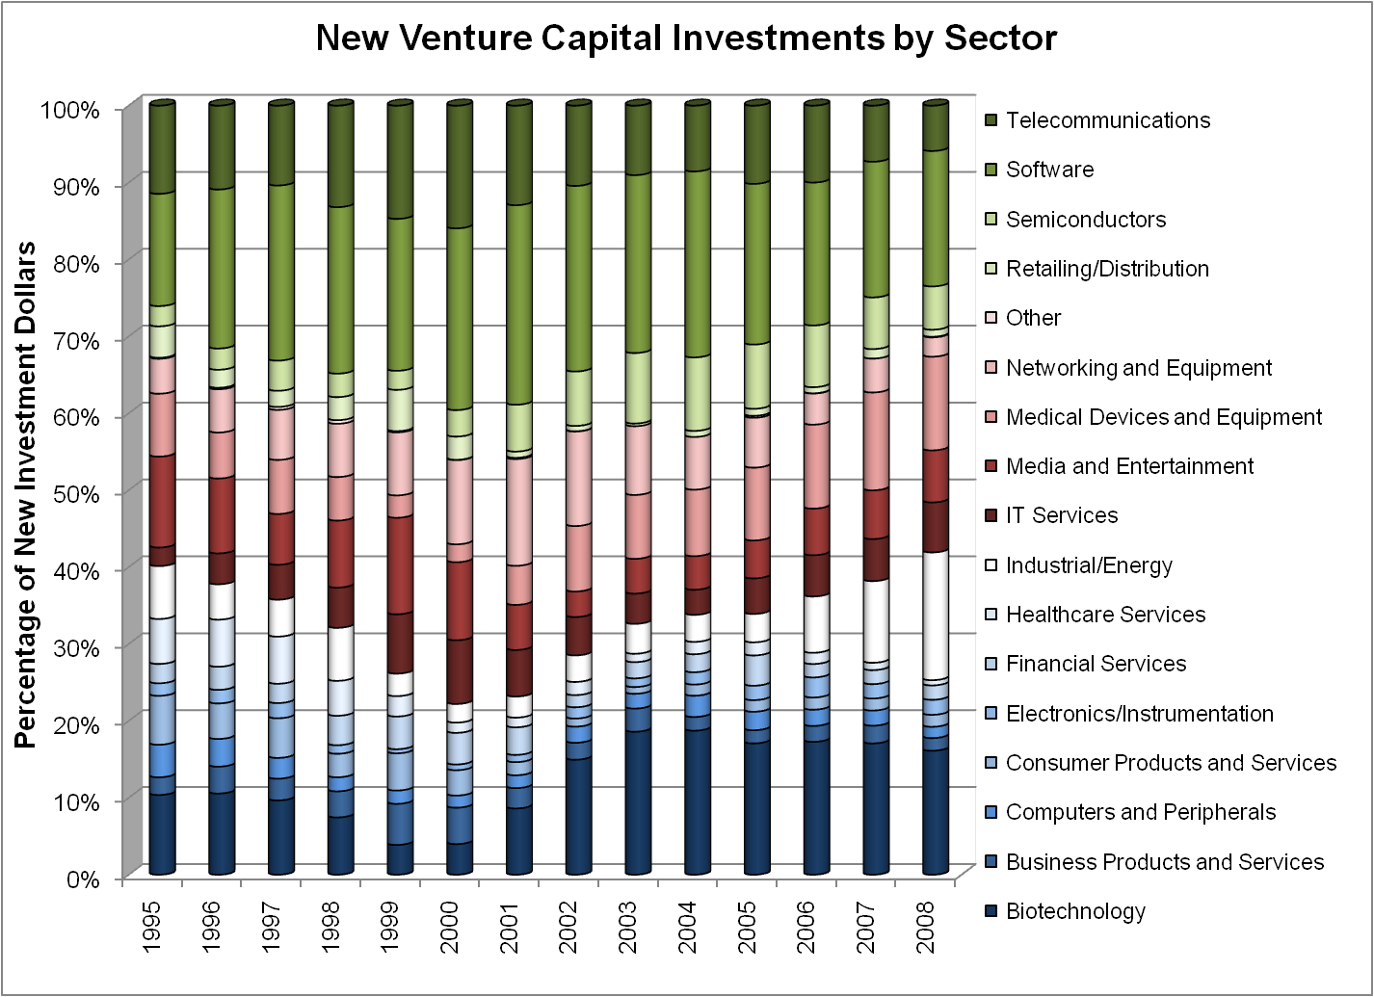
Notes:
Figure 2.2 – New Venture Capital Investments by Sector
Source: PricewaterhouseCoopers/National Venture Capital Association MoneyTree™ Report, Data: Thomson Reuters.

Slide 12
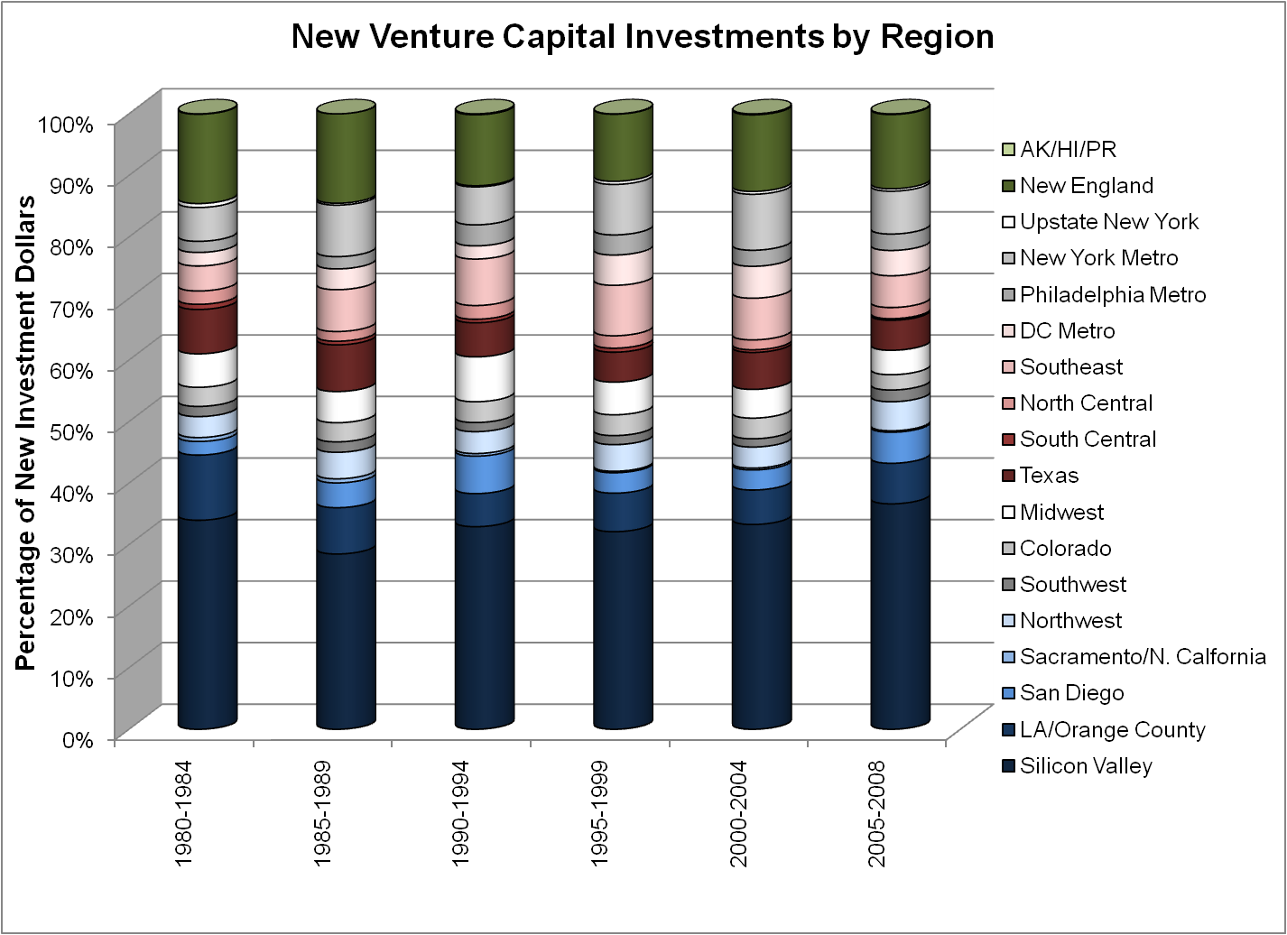
Notes:
Figure 2.3 – New Venture Capital Investments by Region
Source: PricewaterhouseCoopers/National Venture Capital Association MoneyTree™ Report, Data: Thomson Reuters.

Slide 13
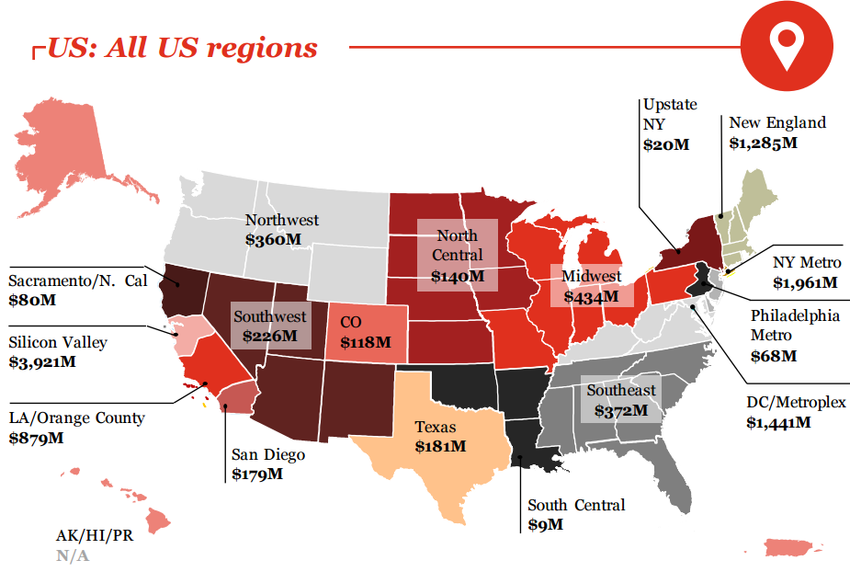
Investments by Region
Source: PwC MoneyTreeTM Report

Slide 14
Venture Capital and Private Equity
VC is a category of private equity
  leveraged buyout funds
  venture capital funds
  mezzanine capital
  distressed debt (quasi-equity)
Venture capital (VC) is investment capital supplied by a specific type of investor, the VC firm
VC firms have a unique structure and focus:
  normally organized as limited partnerships
  invest in high-risk ventures with potential for high growth

Slide 15
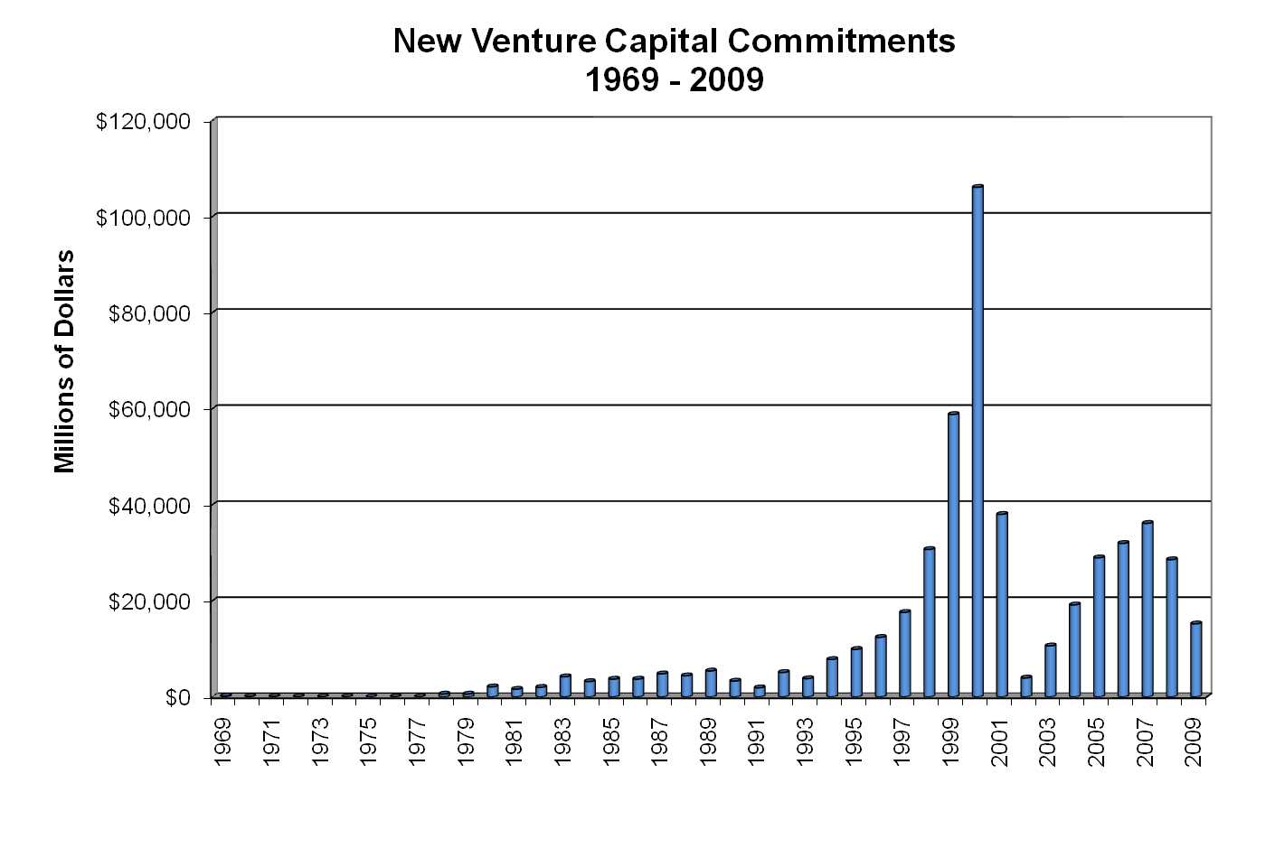
Notes:
Figure 3.1 – New Venture Capital Commitments (1969 - 2008)
Sources: Statistical Abstract of the US. (various issues); Venture Economics Investor Service; Sahlman (1990); National Venture Capital Association.

Slide 16
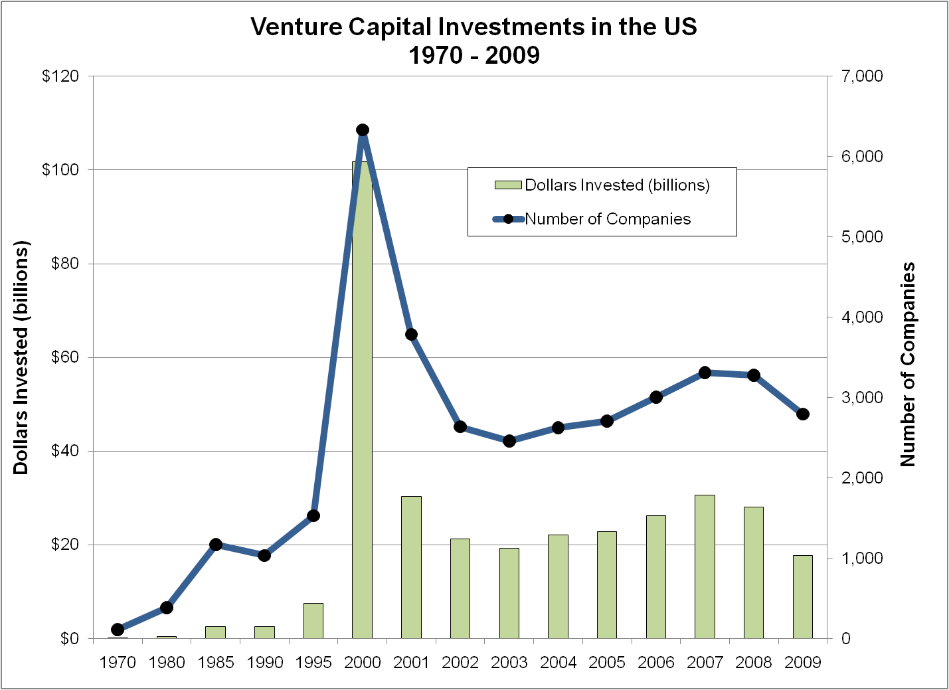
Notes:
Figure 3.2 – Venture Capital Investments in the United States (1970 - 2009)
Source: Venture Impact: The Economic Importance of Venture Capital-Backed Companies to the U.S. Economy, 5th ed., National Venture Capital Association. Source: PricewaterhouseCoopers/National Venture Capital Association MoneyTree™ Report, Data: Thomson Reuters

Slide 17
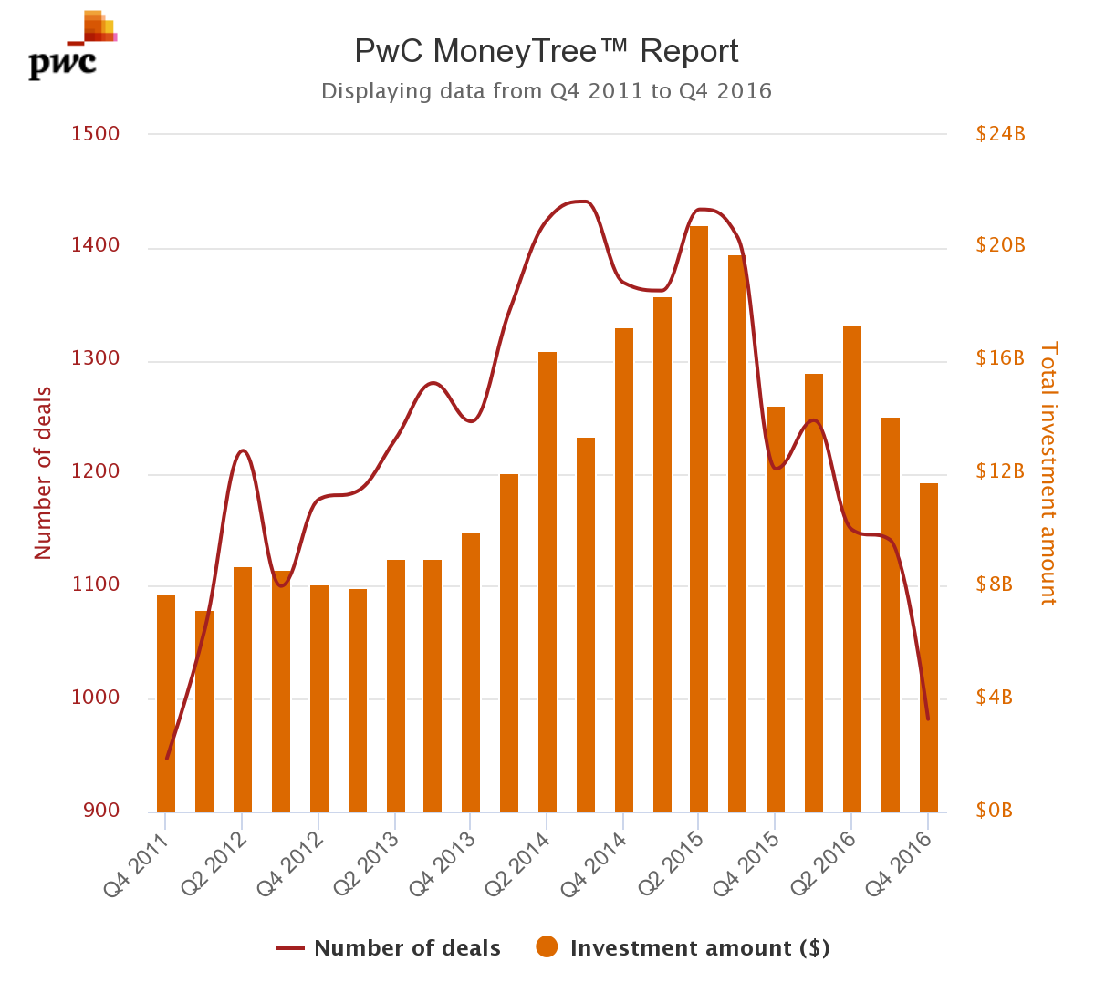
Total equity investments into venture-backed companies
Source: PwC MoneyTreeTM Report

Slide 18
Worldwide Growth of Venture Capital
Factors that have restrained VC growth in other parts of the world
  institutional investors are the key investors in VC funds
    pension funds and endowments
  many countries restrict the investment choices of institutions in ways that exclude venture capital
The fraction of pension fund investments in equity is highly correlated with venture capital investment by country
Outside the US, endowments are not a significant source of VC funding

Slide 19
The Changing Role of Venture Capital
Recent focus on later-stage investment
  2008 Seed/Start-up funding:
    VCs - $1.5 billion
    Angel investors - $9 billion
Importance of institutional investors
  pension funds
  endowments
  insurance

Slide 20
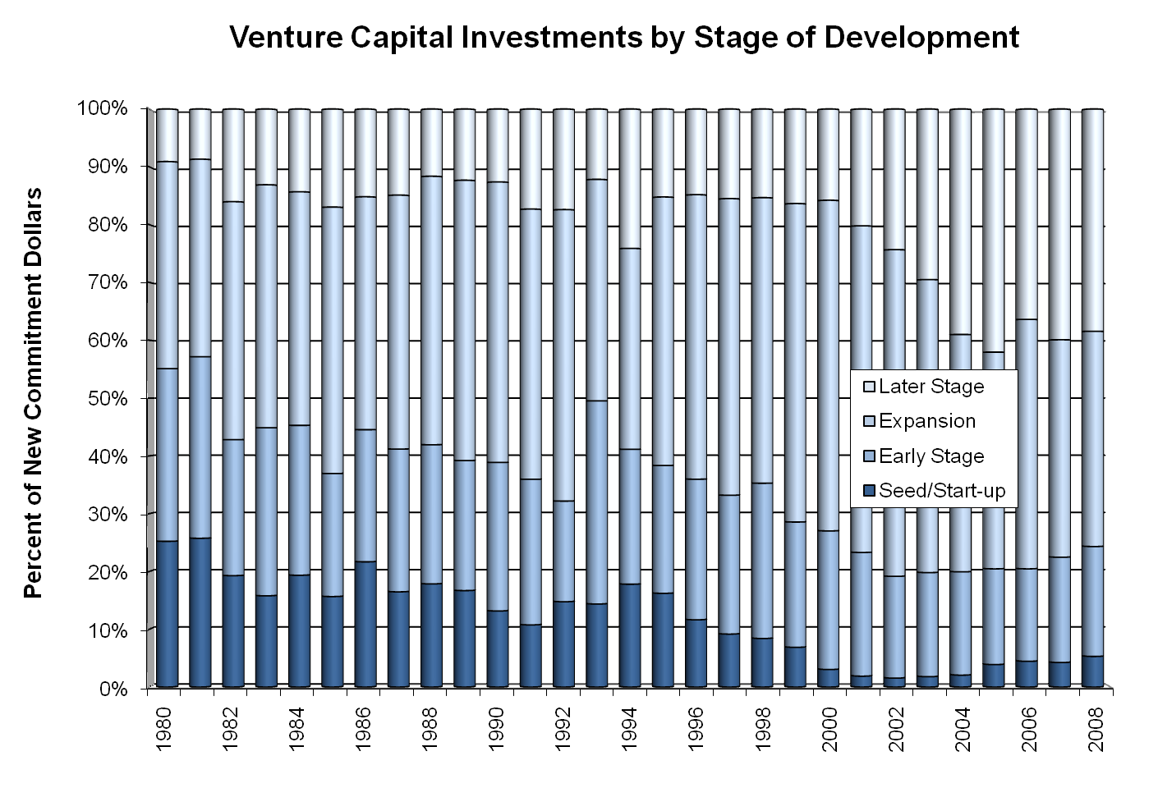
Notes:
Figure 3.4 – Venture Capital Investments by Stage of Development
Sources: National Venture Capital Association Yearbook (various years) and PricewaterhouseCoopers/National Venture Capital Association MoneyTree™ Report.

Slide 21
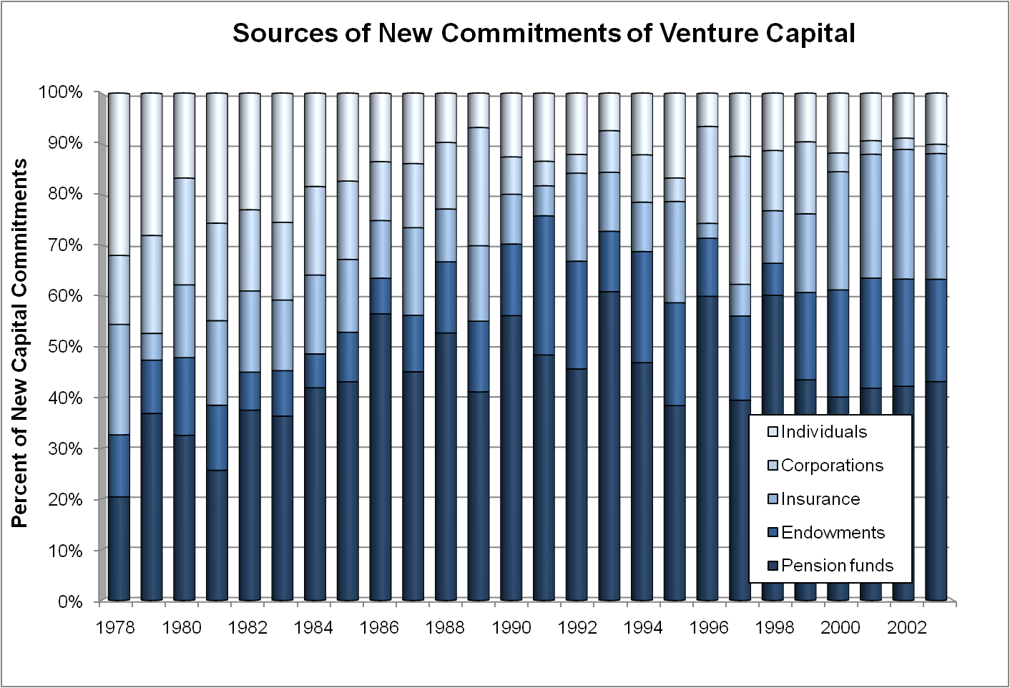
Notes:
Figure 3.5 – Sources of New Commitments of Venture Capital
Source: National Venture Capital Association Yearbook, various years, reported in the 2004-2005 US Statistical Abstract, Table 743.

Slide 22
The Impact of VC on the Economy
For a small industry, VC has a large impact
According to the NVCA
  VC-backed companies account for 11% of private sector employment and 21% of GDP
  VC-backed companies have materially higher rates of job and revenue growth
  in tech sectors, 70% of employees work for companies that were formerly VC-backed

Slide 23
The Organization of VC Firms
VC firms perform the following tasks:
  raise capital for long term investment with little evidence of short term returns
  screen a large number of business plans, identifying the few ventures likely to succeed
  add value to the ventures in which they invest
  adapt to changing information and opportunities
  redeploy human capital to maximize value creation

Slide 24
The Organization of VC Firms
Advantages of the limited partnership structure
  limited liability for investors
  finite life
  allocation of returns
The general partner (GP) is the fund organizer and is responsible for raising investment capital from the limited partners (LPs)
The GP deploys the capital by investing in portfolio companies, which they monitor until harvest

Slide 25
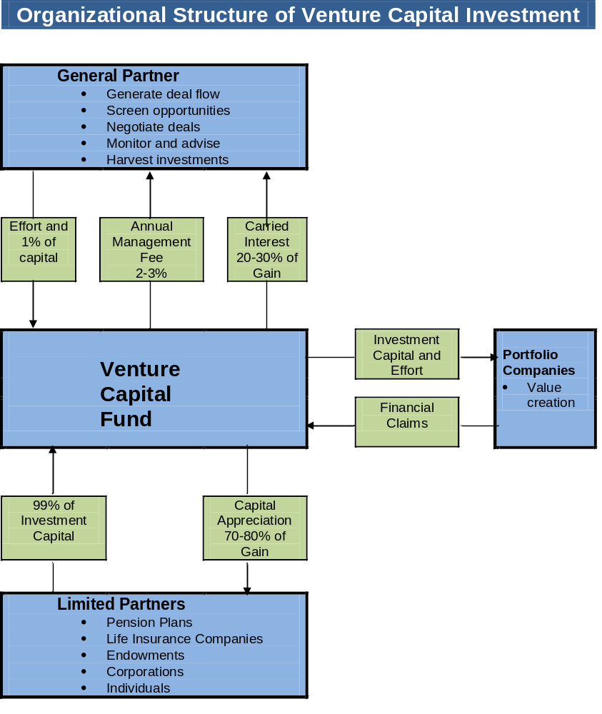
Notes:
Figure 3.7 – Organizational Structure of Venture Capital Investment
VC funds usually are organized as limited partnerships. The GP manages the fund, and LPs provide most of the investment capital. The fund invests in a portfolio of new ventures.

Slide 26
Commitments, Calls, and Reputation
Fund returns are maximized if money is supplied by LPs only when it is needed
  LPs commit to invest capital when called upon to do so
  the GP makes capital calls as investment opportunities are identified
  the GP and other LPs are relying on each LP to honor the capital commitment
  LP reputation and the ability to respond to capital calls are important to fund performance
  capital calls enables a VC fund to operate with little internal liquidity

Slide 27
The Investment Process
Funds are usually designed to last about 10 years
The beginning date is the date of first closing
The role of the GP changes over the life of the fund
  capital raising and opportunity identification
  monitoring, adding value, and pruning bad investments
  harvesting the successes

Slide 28
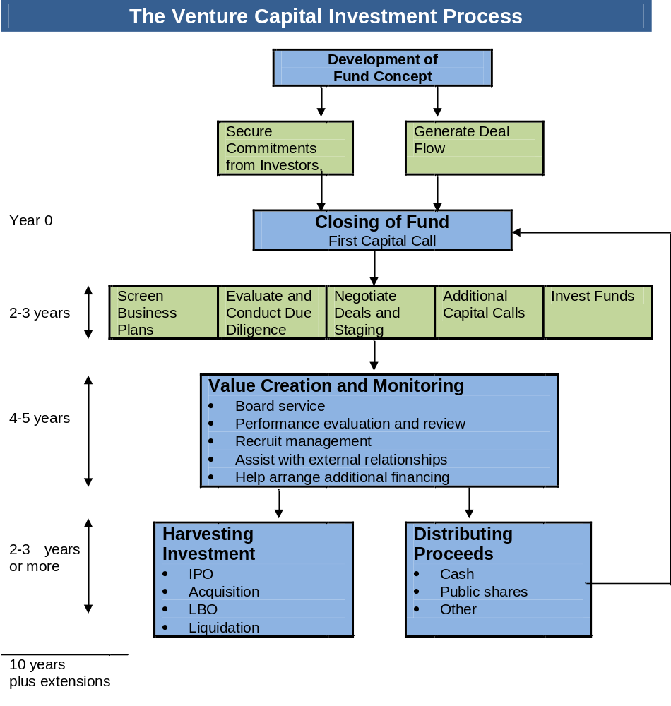
Notes:
Figure 3.9 – The Venture Capital Investment Process

Slide 29
Why Limited Partnership?
Solves many of the managerial problems inherent in new venture investing
GP is able to concentrate on opportunities in which the partner’s expertise adds the most value
Mitigates the need to continuously value each portfolio investment
Makes efficient use of the liquidity of large institutional investors
LP form is not universal

Slide 30
Clustering of Activities
VC firms tend to cluster in geographic areas
  Silicon Valley, Route 128
Agglomeration economies
  efficiencies are achieved by being close to investees, rivals, and other market participants
  industry trends are easier to monitor
  access to specific human capital is enhanced

Slide 31
How VCs Add Value
Selecting investments and negotiating deals
  an investment is more attractive if it is well managed and unlikely to require much assistance
Selecting entrepreneurs who are likely to be successful
Changing the management team
  more than half of founding entrepreneurs are replaced
Allocating effort efficiently
Monitoring and advising portfolio companies

Slide 32
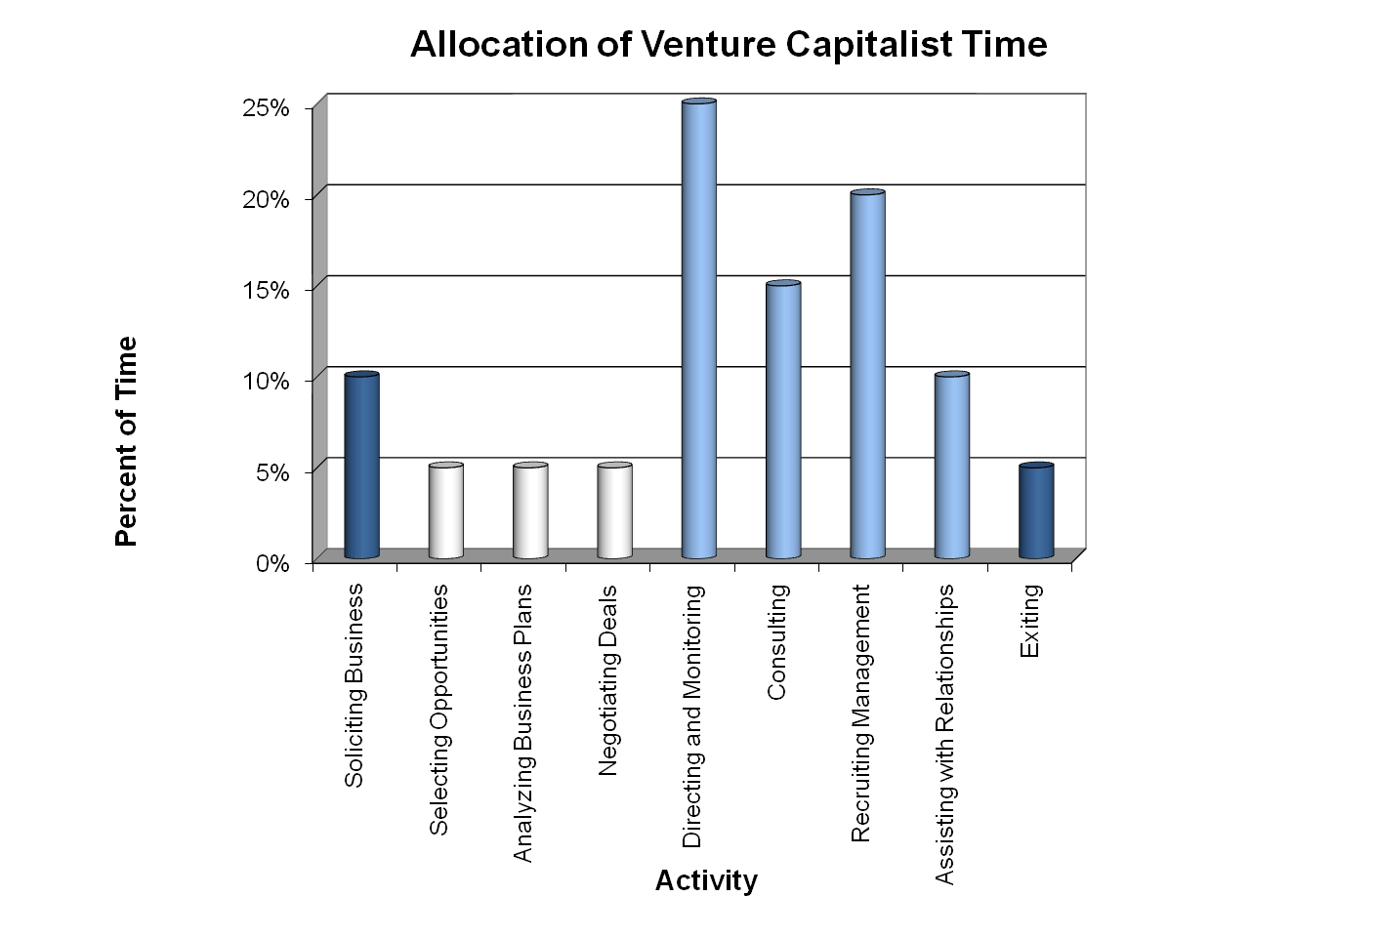
Notes:
Figure 3.10 – Allocation of Venture Capitalist Time
Managing and monitoring investments account for the largest fraction of time. Activities related to finding and making investments and those related to raising and returning investment capital account for significantly smaller fractions of effort.
Source: Zider (1998).

Slide 33
Syndication and Venture Capital
Syndication occurs when VCs co-invest in a venture
Lead investor has most direct involvement
Why syndicate?
  pool VC human capital
  more diversified portfolios
  barrier to entry of new VC firms
  reduce informational asymmetries

Slide 34
VC Pyramid
1000
Read business plans
50
Due diligence
10
Invest
1 Hit (50 – 75 + % ROI)
4 Moderate success (30-35% ROI)
10 Investment Yield
3 Living dead (0% ROI)
2 Failures (Total loss)

Slide 35
Impact of Venture Capital-backed Companies
Company Ticker 2016 Sales 2017 EquityMarket (billions) Value (billions)
Apple Computer AAPL $ 218 $ 735
Google GOOGL 90 600
Facebook FB 28 400
Microsoft MSFT 86 500
Amazon AMZN 136 400

Slide 36
Characteristics of the Classical Superdeal from Investor’s Perspective
Mission
  Build a highly profitable & industry-dominant company.
  Go public or merge within 4 to 7 years at a high P/E multiple
Complete Management Team
  Led by industry “superstar”
  Possess proven entrepreneurial, general management, & P&L experience in business
  Have leading innovator or technology/marketing head
  Possess complementary & complete skills
  Have unusual tenacity, imagination, & commitment
  Possess reputation for high integrity
Proprietary Product
  Has significant competitive lead & unfair advantages
  Has product or service with high value-added properties resulting in early payback to user
  Has or can have exclusive contractual or legal rights
Large and Rapidly Growing Market
  Will dominate a $50 million entrant in 5 years
  Has sales currently at $100 mil. or more, and growing at 25%/year
  Has no dominant competitor now
  Has clearly defined customers and distribution channels
  Possesses forgiving & rewarding economics, such as:
    Gross Margins of 40% to 50%, or more
    10% or more profit after tax
    Early positive cash flow & break-even sales
Deal valuation & ROR
  Has “digestible” first round capital requirements (i.e., greater than $1 mil. and less than $10 mil)
  Able to return 10 times original investment in 5 years at P/E of 15 times or more
  Has possibility of additional rounds of financing at substantial markup
  Has antidilution and IPO subscription rights

